Slide 1

Sales Data Analysis for BOS Brands
Final Round Interview – Sales Data Analyst Role
Name: Sibusiso
Surname: Mbatha

Slide 2

Introduction
This sales data analysis report provides insights into the performance of our company compared to the brands over the past six months, three months, and one month.
By analyzing market share, revenue trends, regional performance, and pack type contributions, this report aims to identify growth opportunities and formulate actionable recommendations to enhance our market position and drive sales growth.

Slide 3
Market Share Analysis
Brands | 2023 Sales | 2024 Sales | Market Share 2023 | Market Share 2024 | Year-over-Year Growth (YoY)
BOS | 4599019 | 2768783 | 11.5234% | 13.9600% | -39.7962%
Deney's Swiss | 1690 |  | 0.0042% | 0.0000% | -100.0000%
Eden Tea | 1508 | 6657 | 0.0038% | 0.0336% | 341.4456%
Elgin Dew |  | 9 | 0.0000% | 0.0000% | 0.0000%
Frutas | 37130 | 27331 | 0.0930% | 0.1378% | -26.3911%
Fuze Tea | 35638 | 35249 | 0.0893% | 0.1777% | -1.0915%
Kombucha | 4155 | 1896 | 0.0104% | 0.0096% | -54.3682%
Lipton | 32793779 | 15882927 | 82.1685% | 80.0804% | -51.5673%
Manhattan | 2392028 | 1089183 | 5.9935% | 5.4916% | -54.4661%
Nestea | 21 |  | 0.0001% | 0.0000% | -100.0000%
PNP Ceylon | 0 | 19 | 0.0000% | 0.0001% | 0.0000%
Smart Choice | 19047 | 5709 | 0.0477% | 0.0288% | -70.0268%
Toni Glass | 1004 | 712 | 0.0025% | 0.0036% | -29.0837%
Wellness Blend | 25360 | 15248 | 0.0635% | 0.0769% | -39.8738%
Grand Total | 39910379 | 19833723 | 100.0000% | 100.0000% | -50.3043%

Slide 6
Market Share Analysis For 6 Months
Brands |  | Feb | Mar | Apr | May | Jun | Jul | 2023 Total | Feb | Mar | Apr | May | Jun | Jul | 2024 Total
BOS |  | 374090 | 332955 | 363527 | 286029 | 256998 | 270985 | 1884584 | 461602 | 398140 | 305271 | 396909 | 345659 | 371067 | 2278648
Deney's Swiss |  | 757 | 177 | 7 | 7 | 14 |  | 962 |  |  |  |  |  |  | 0
Eden Tea |  |  |  |  |  |  |  | 0 | 839 | 1065 | 1418 | 1167 | 383 | 616 | 5488
Elgin Dew |  |  |  |  |  |  |  | 0 |  |  |  |  |  |  | 0
Frutas |  | 2528 | 3537 | 3064 | 3145 | 3513 | 2647 | 18434 | 4807 | 4435 | 3740 | 3588 | 3729 | 3682 | 23981
Fuze Tea |  | 403 | 3055 | 2425 | 1343 | 882 | 3693 | 11801 | 5670 | 9474 | 4178 | 1529 | 2350 | 7385 | 30586
Kombucha |  | 388 | 294 | 297 | 237 | 421 | 212 | 1849 | 267 | 324 | 263 | 120 | 237 | 416 | 1627
Lipton |  | 3313359 | 3385137 | 2678643 | 2478098 | 2254433 | 2447363 | 16557033 | 2548971 | 2606442 | 1976469 | 2052655 | 1904191 | 2276015 | 13364743
Manhattan |  | 212103 | 238049 | 212379 | 171540 | 147654 | 142578 | 1124303 | 176036 | 190397 | 138549 | 149292 | 116466 | 137424 | 908164
Nestea |  |  |  |  |  |  | 21 | 21 |  |  |  |  |  |  | 0
PNP Ceylon |  |  |  |  |  |  |  | 0 |  | 19 |  |  |  |  | 19
Smart Choice |  |  | 119 | 2811 | 2636 | 2067 | 1569 | 9202 | 178 | 915 | 1330 | 2338 |  |  | 4761
Toni Glass |  | 77 | 84 | 114 | 125 | 70 |  | 470 |  | 14 | 215 | 351 | 16 | 116 | 712
Wellness Blend |  | 2582 | 3619 | 1842 | 1319 | 627 | 2900 | 12889 | 3095 | 1965 | 1240 | 2155 | 1942 | 2131 | 12528
Grand Total |  | 3906287 | 3967026 | 3265109 | 2944479 | 2666679 | 2871968 | 19621548 | 3201465 | 3213190 | 2432673 | 2610104 | 2374973 | 2798852 | 16631257

Slide 8
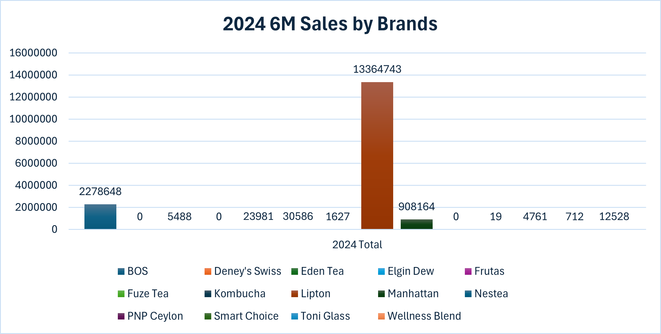

Slide 9
Market Share Analysis For 1 Month
Brands | 2023 Jul | 2024 Jul
BOS | 270985 | 371067
Deney's Swiss
Eden Tea |  | 616
Elgin Dew
Frutas | 2647 | 3682
Fuze Tea | 3693 | 7385
Kombucha | 212 | 416
Lipton | 2447363 | 2276015
Manhattan | 142578 | 137424
Nestea | 21
PNP Ceylon
Smart Choice | 1569
Toni Glass |  | 116
Wellness Blend | 2900 | 2131

Slide 10
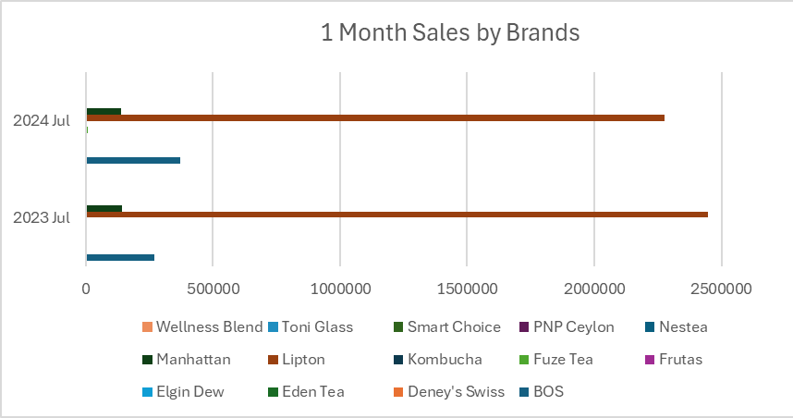

Slide 11
Regional Comparison
Region | Feb-23 | Mar-23 | Apr-23 | May-23 | Jun-23 | Jul-23 | Feb-24 | Mar-24 | Apr-24 | May-24 | Jun-24 | Jul-24
Eastern Cape | 242998 | 258847 | 227772 | 171005 | 159113 | 182402 | 207634 | 232704 | 170103 | 177798 | 171847 | 171504
Inland | 2385029 | 2471415 | 1989312 | 1919975 | 1753106 | 1863875 | 1985854 | 2012778 | 1489332 | 1663733 | 1503344 | 1841150
Kwazulu Natal | 387701 | 423985 | 360015 | 269668 | 264744 | 281505 | 272554 | 281947 | 225999 | 236825 | 229065 | 256670
Western Cape | 890559 | 812779 | 688010 | 583831 | 489716 | 544186 | 735423 | 685761 | 547239 | 531748 | 470717 | 529528
Grand Total | 3906287 | 3967026 | 3265109 | 2944479 | 2666679 | 2871968 | 3201465 | 3213190 | 2432673 | 2610104 | 2374973 | 2798852

Slide 12
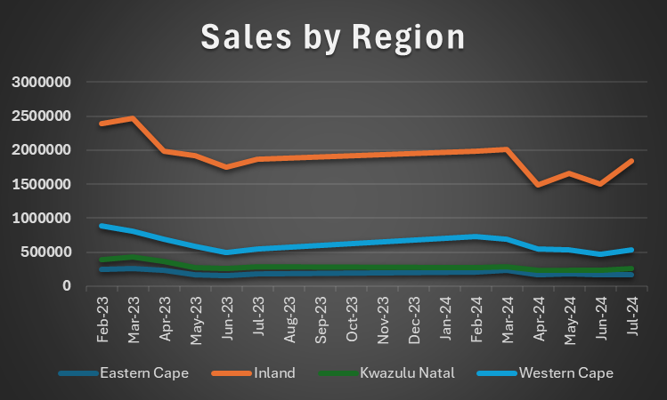

Slide 13
Pack Contribution Analysis
Pack Contribution | Sales
1L - 1.5L | 30757633
200ml | 4783484
380ml | 839
3L | 1990389
500ml | 14355590
Can | 7856167
Grand Total | 59744102

Slide 15

Insights and Recommendations
Focus on High-Growth Regions: We can allocate more resources and marketing efforts to inland and Western Cape, because they are showing strong growth potential.
Optimize Product Mix: Based on analysis 1L - 1.5L and 500ml contribute the most.
Address Underperforming Regions: We can develop another or implement another targeted strategies.

Slide 16

Insights and Recommendations continuous
New Product Development: Based on market share I suggest that the company can rethink of designing or making another product which is more like Lipton.
Competitive Pricing Strategies: We can implement pricing strategies to better compete in areas where competitors are gaining market share.

Slide 17

Conclusion
By focusing on strategic pricing, targeted marketing, innovation, and brand positioning, we can enhance overall brand performance and achieve sustained sales growth.

Slide 18

Thank you

